Slide 1
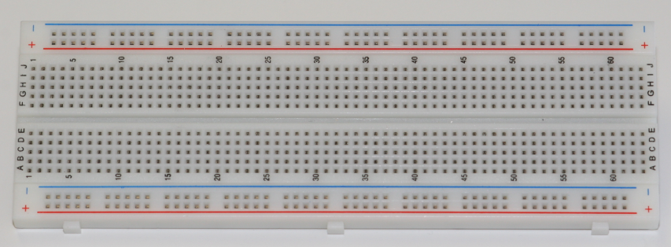
What is a Breadboard?
A breadboard, sometimes called a proto-board, is a reusable platform for temporarily built electronic circuits.
Notes:
Explanation of what a breadboard is.
The Breadboard
Digital Electronics TM
1.2 Introduction to Analog
Project Lead The Way, Inc.
Copyright 2009

Slide 2
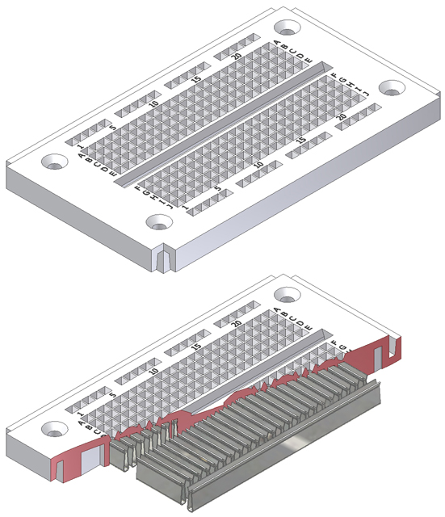
How A Breadboard Works
Electric component leads and the wire used to connect them are inserted into holes that are arranged in a grid pattern on the surface of the breadboard.
A series of internal metal strips serve as jumper wires. They connect specific rows of holes.
Top View
Cut-Away View
Notes:
Overview of how a breadboard works.
The Breadboard
Digital Electronics TM
1.2 Introduction to Analog
Project Lead The Way, Inc.
Copyright 2009

Slide 3
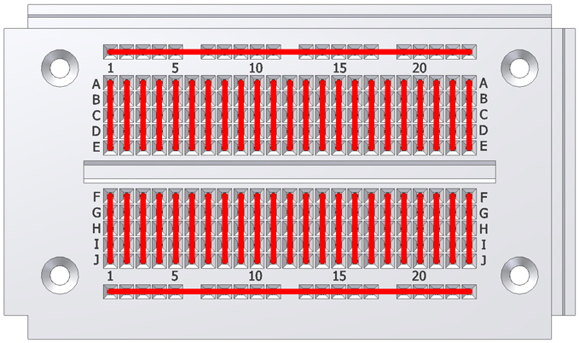
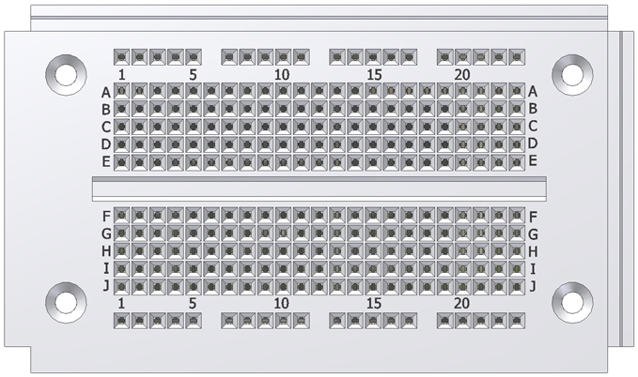
Breadboard Connections
Notes:
An overview of how the breadboard holes are interconnected.
The Breadboard
Digital Electronics TM
1.2 Introduction to Analog
Project Lead The Way, Inc.
Copyright 2009

Slide 4
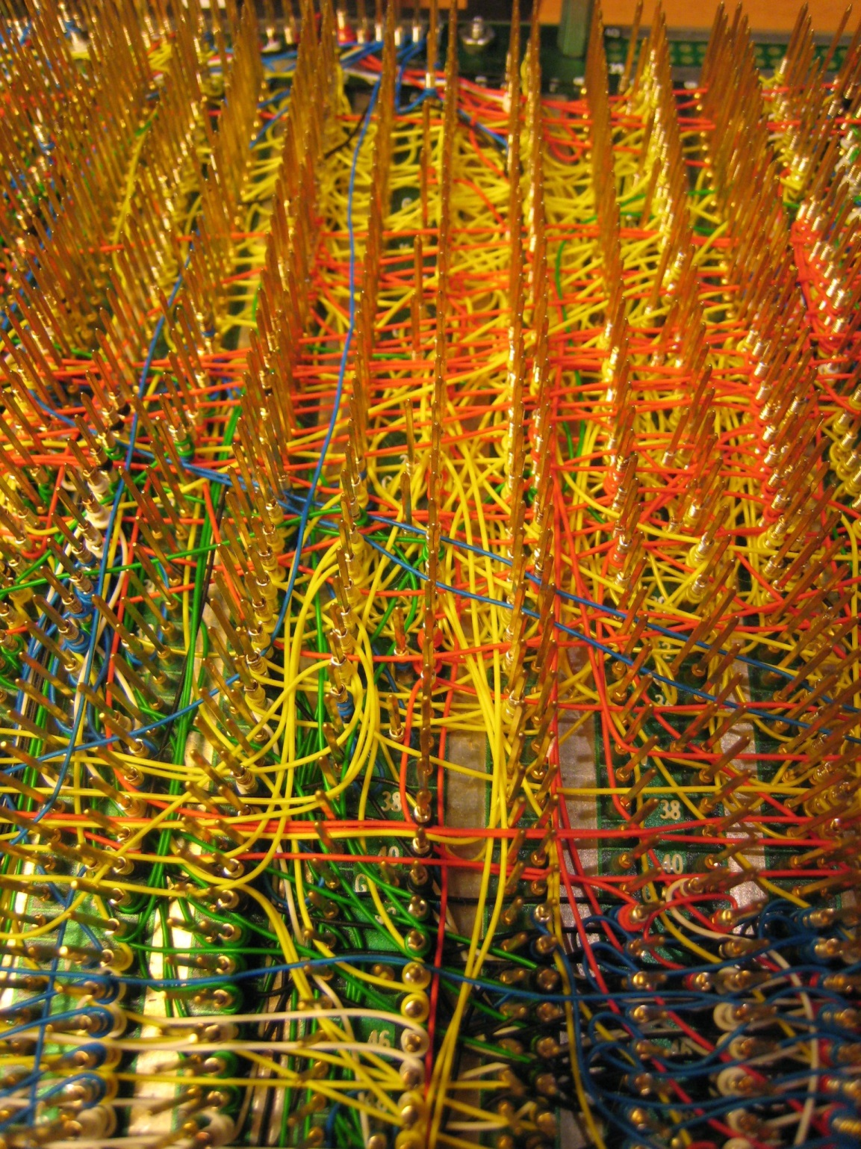

Slide 5
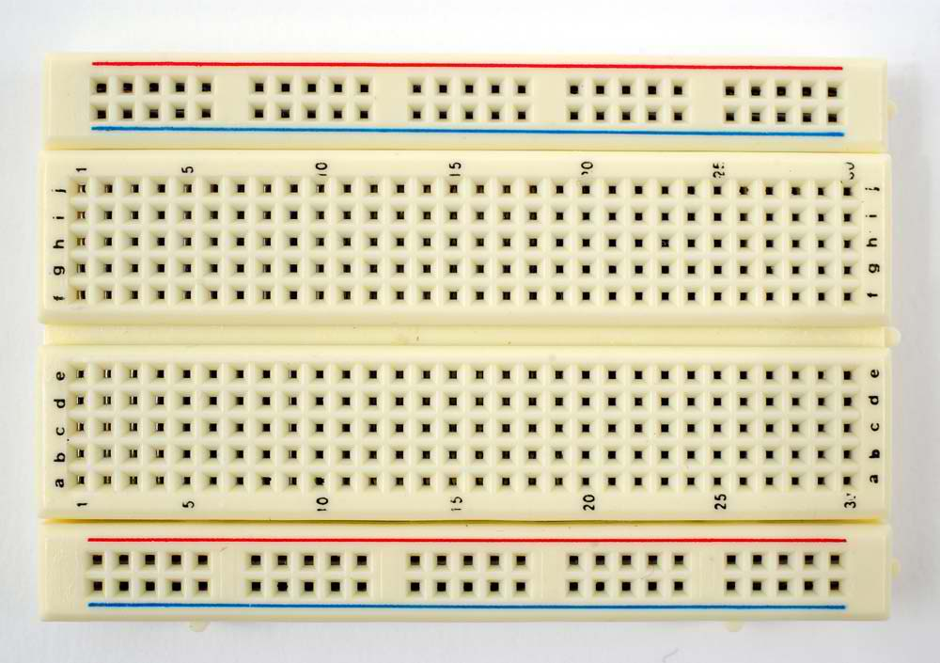

Slide 6
